Slide 1

ICD PROJECT
Members:
Josue Cobos Salvador
Enmanuel Magallanes Pinargote

Slide 2
Main dataset descripcion
The dataset used contains information on Shippify deliveries on Santiago of Chile. The available information is as follows:
ID of delivery: unique identifier.
Route ID of delivery: unique identifier of a route (contains more of tow deliveries).
Creation date: timestamp of creation delivery.
Delivery type: could be Flex or Slot.
Slot: are tasks that have a collection date, of the package(s), with a maximum time window of one hour from the specified time.
Flex: are those tasks that have a collection interval of more than one hour, maximum 12 hours.
Cost: money paid to the shipper.
Total size: size of delivery.
Distance: distance from pickup location to drop off location.
Pickup and drop off location: latitude and longitude for pickup and drop off.
Notes:
Describo el data set

Slide 3
Traffict dataset descripcion
This dataset was obtained from TOMTOM that service to fetch information about traffic of cities. The dataset used contains information about of traffic on Santiago de Chile. The available information is as follows:
ID of segment: unique identifier.
Polygon: area of Santiago of chile.
Traffict segments: list of object (JSON) with this structure:
Time slide: slide of 3 hours of the day
Traffict: intensity of traffict from 0 to 1
Notes:
Describo el data set

Slide 4
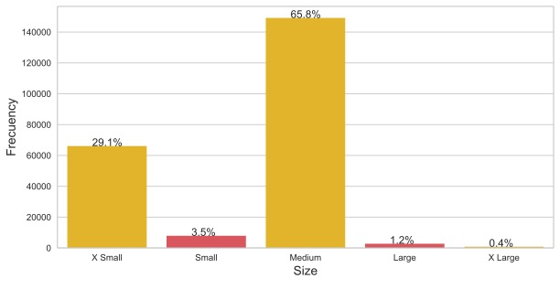
Size of deliveries
Notes:
Mayor porcentaje de tareas Medium y X Small

Slide 5
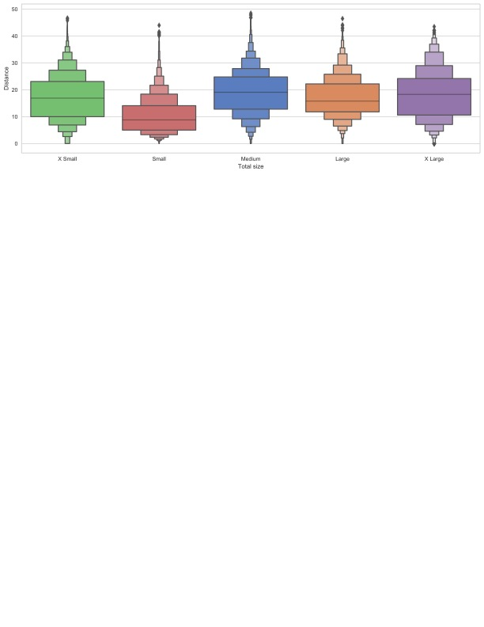
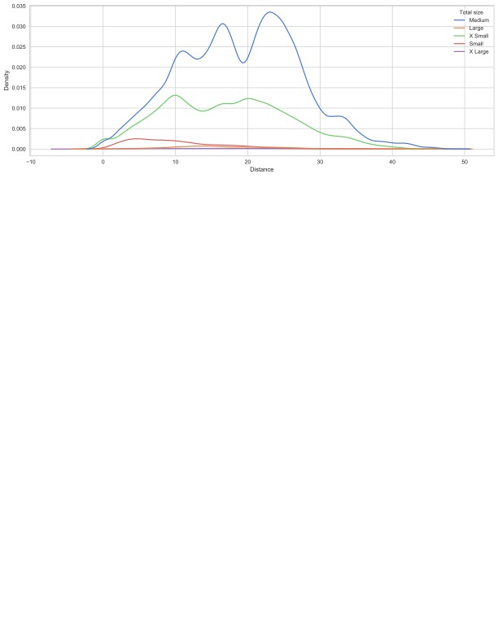
Size of deliveries
Notes:
Las distnacias de tareas por su tipo de tamaño, Small mas cortas y Medium mas largas, el resto muy similar

Slide 6
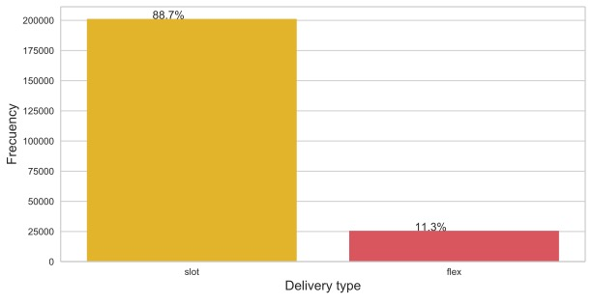
Delivery type

Slide 7
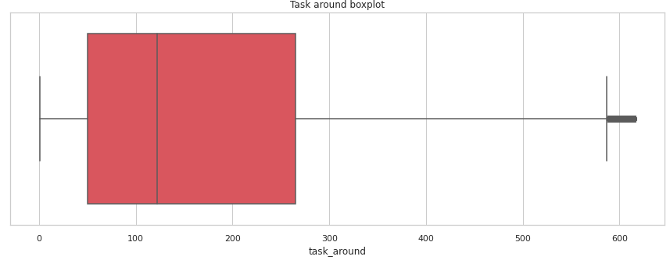
Task around

Slide 8
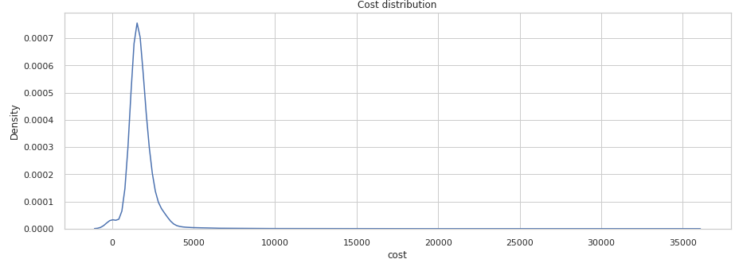
Cost

Slide 9
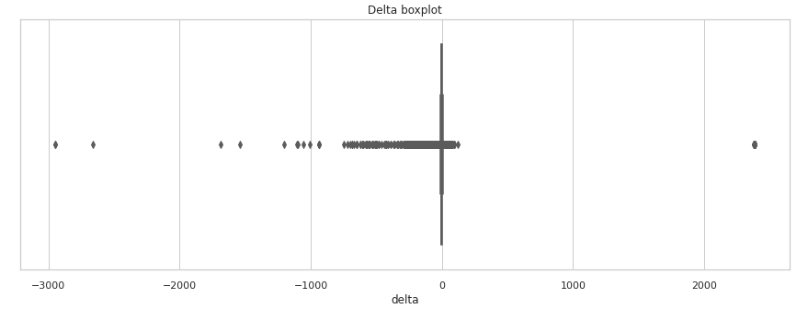
Delay

Slide 10
Delivery type
Notes:
En este FaceGrid ponemos obsrvar como es la relacion del cost vs la distancia segun el tipo de tarea y su tamaño, X Small y Small son las que presentan una correlacion debil positiva.

Slide 11
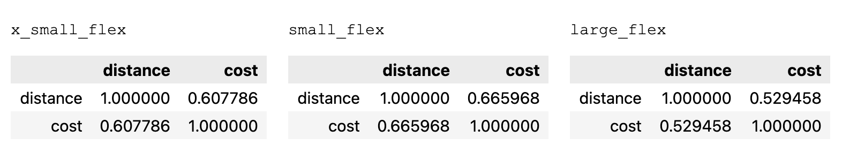
Correltion Distance vs Cost
Notes:
Aqui la podemos ver de manera cuantitativa

Slide 12
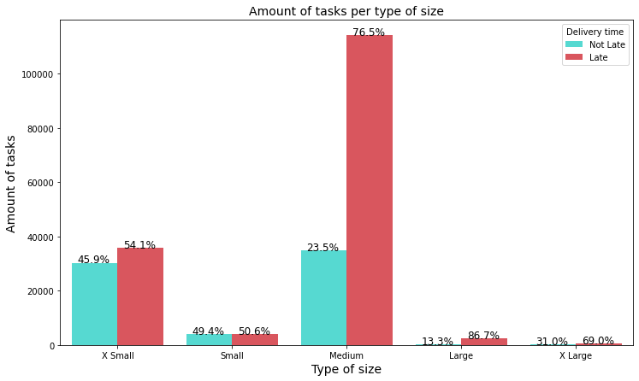
Is the total weight of packages a factor affecting the timeliness of deliveries?
Notes:
El peso de las tareas es un factor que afecta a su tiempo de entrega? Aqui lo importante no es ver tanto la cantidad de tareas por el peso, si no, la diferneccia de porcentaje de tareas atrasadas y no atrasadas. Como podemos observar la diferecnia entre el pocertange de tareas no atrasada y las atrasadas aumenta conforme aumenta el peos de la tarea.

Slide 13
Are tasks with fewer neighboring deliveries* taking longer to reach their delivery point?
To carry out this analysis we first have to determine what would be the time window (hours) and radius (kilometers) around a task to be used. For this we analyzed the distance and average time difference of a route in the delivery path, from the first package to the last one. The following results were obtained:
Mean time: 3.12 hours
Mean distance: 3.20 Km.
* We define neighboring deliveries as all those deliveries that are less than or equal to X Km away from the same and their delivery date is within T hours of the same.
Notes:
Son las tareas con menos cantidad de entregas vecinas aquellas que llegan con mas atrassos? Definimos a una entrega como entrega vecina cuando esta tien una fehca de entrega que esta dentro de una ventdad de tiempo repsecto a una tarea pivote y tambien su ubicacion esta dentro de un perimetro con rexpecto a la entrega pivote. Entonces para ellos calculamos el tiempo que se toma desde el primer al ultimo dropoff y tambine calculamos su distancia, para savar la ventana de tiempo y perimetro.

Slide 14
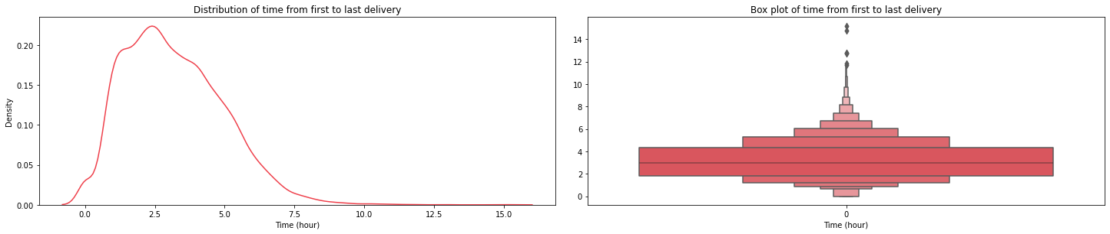
Mean time on drop off step

Slide 15
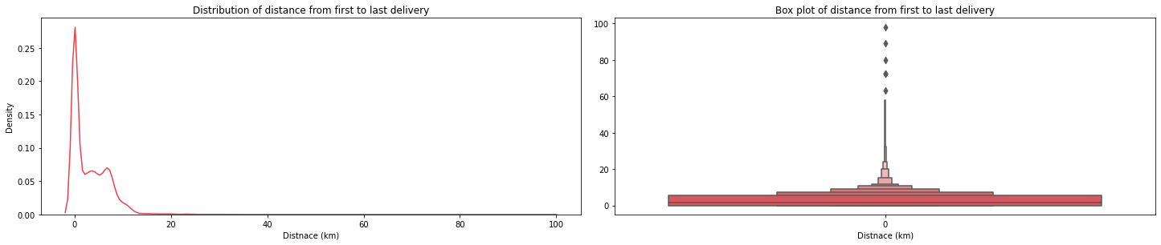
Mean distance on drop off step

Slide 16
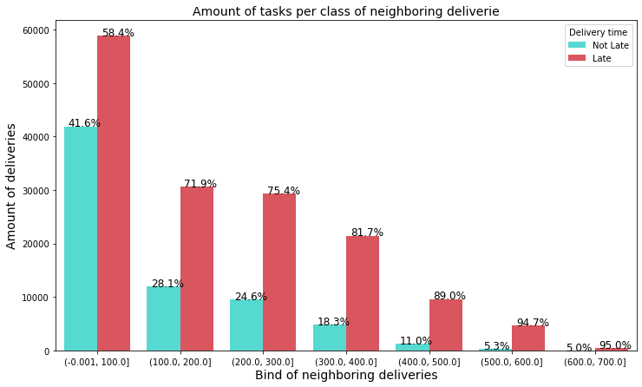
Responding to the question about neighboring deliveries

Slide 17
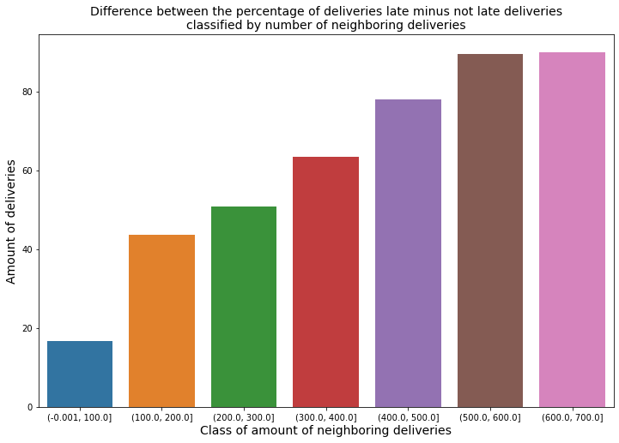
Plot of percentage differences

Slide 18
Neighboring delivery's location
Notes:
Delay size y facegrid con el total_size (row con type)?
Delay temporalidad
Enfocar en las comunas

Slide 19
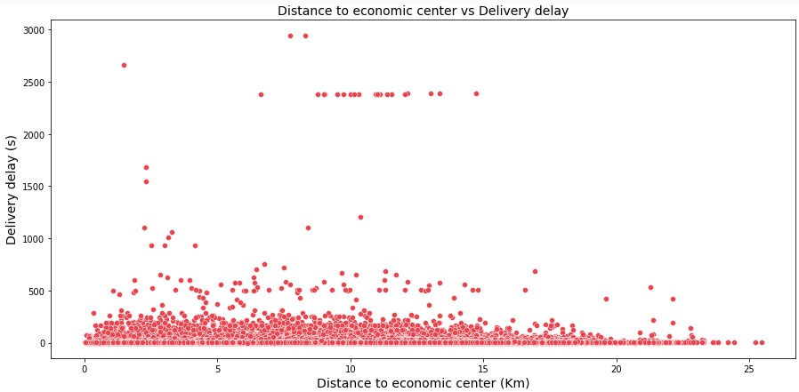
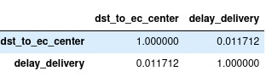
Correlation between delay and distance
Are those deliveries that are further from the economic center of Santiago de Chile those with the longest delivery delay?

Slide 20
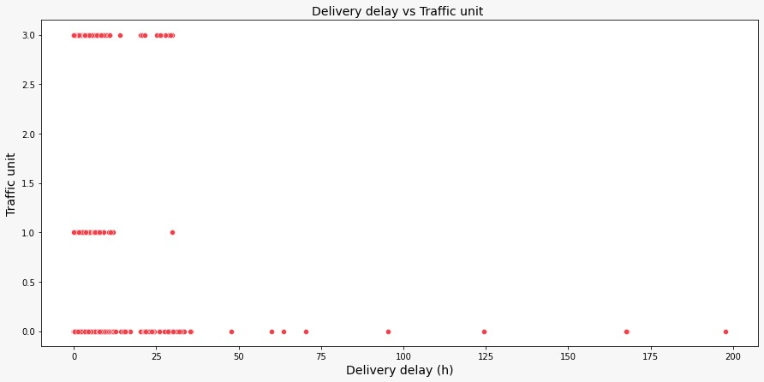
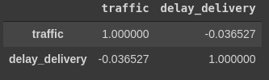
Correlation between delay and distance

Slide 21
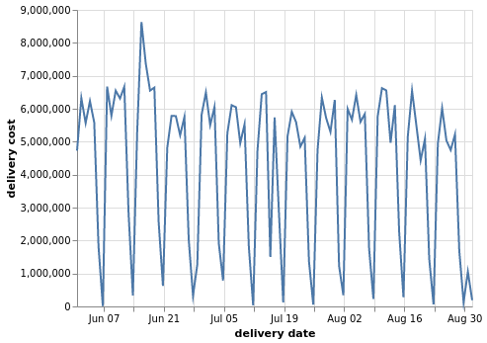
Cost vs date

Slide 22
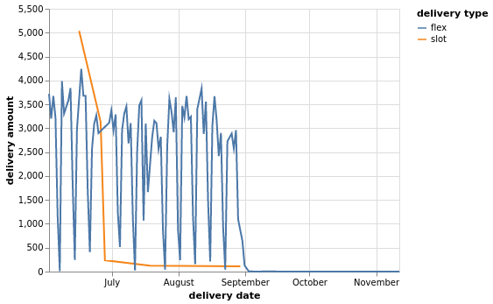
Delivery type amount vs date

Slide 23
Clustering (features analysis)
What are the common characteristics of the tasks with delay on delivery time?

Slide 24
Clustering (features analysis)

Slide 25
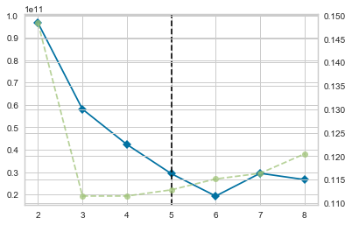
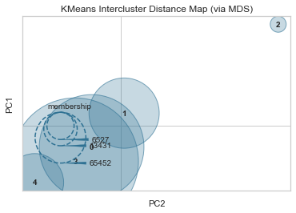
Clustering without standardization

Slide 26
Clustering without standardization

Slide 27
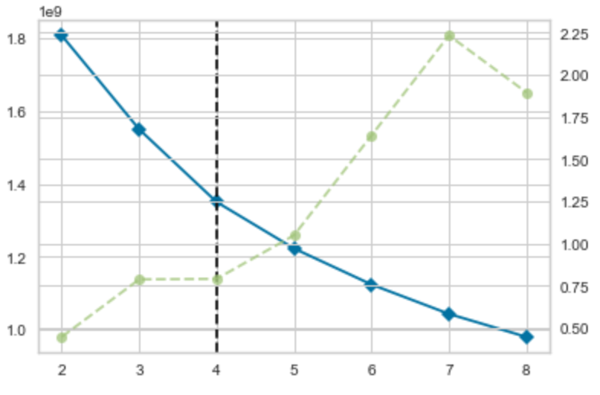
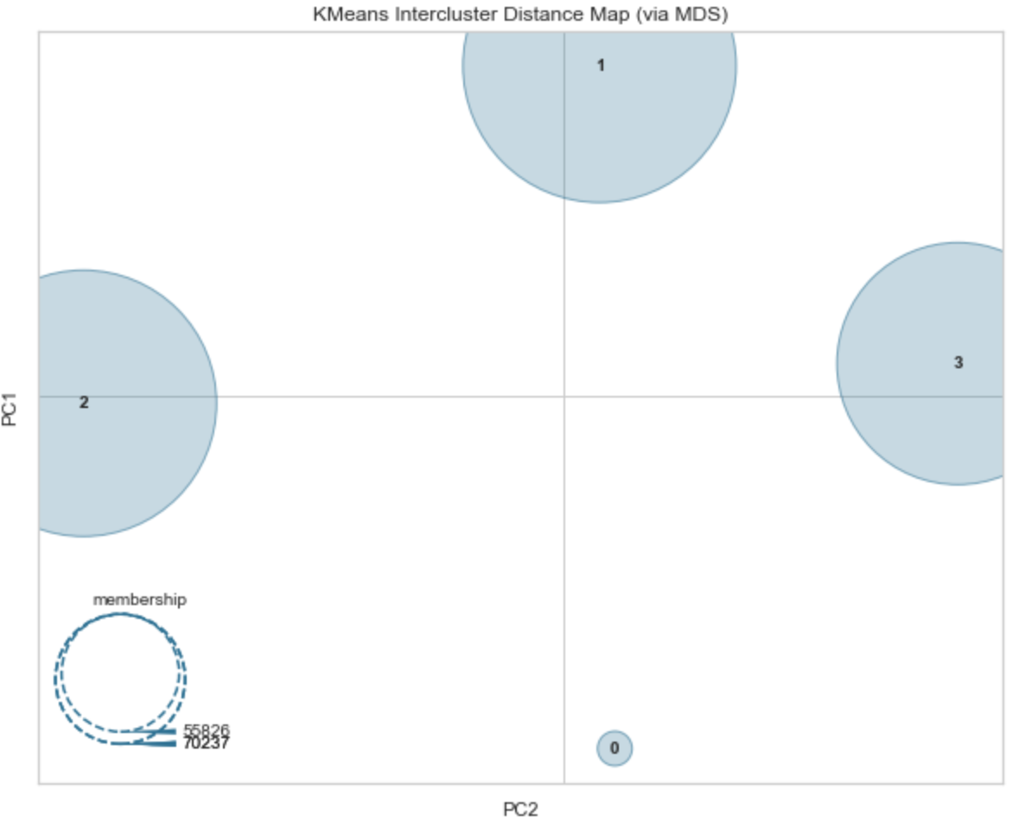
Clustering with standardization
Cluster | Population
Cluster 0 | 25518
Cluster 1 | 75247
Cluster 2 | 70237
Cluster 3 | 55826

Slide 28
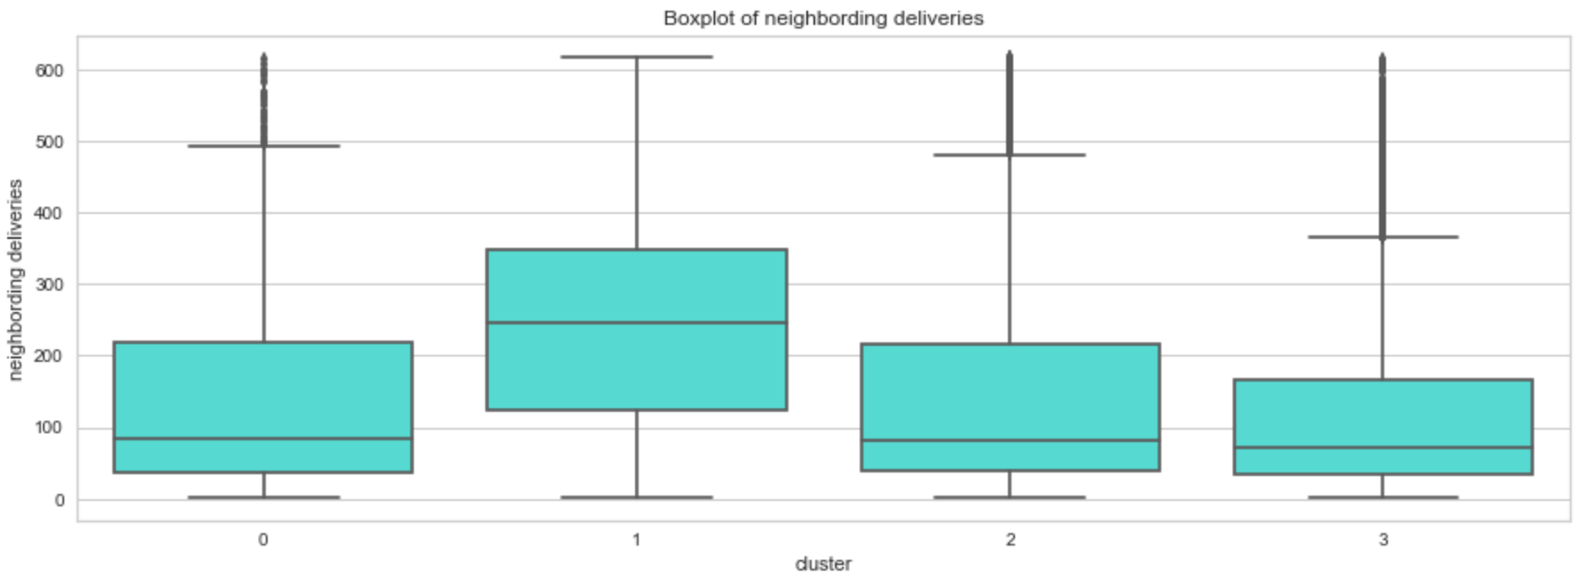
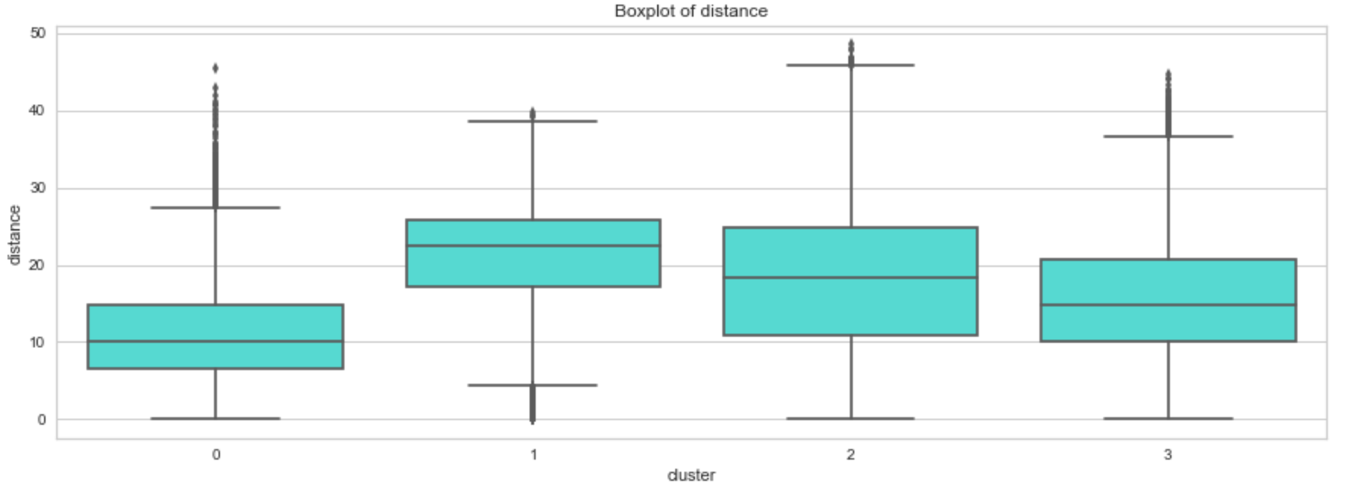
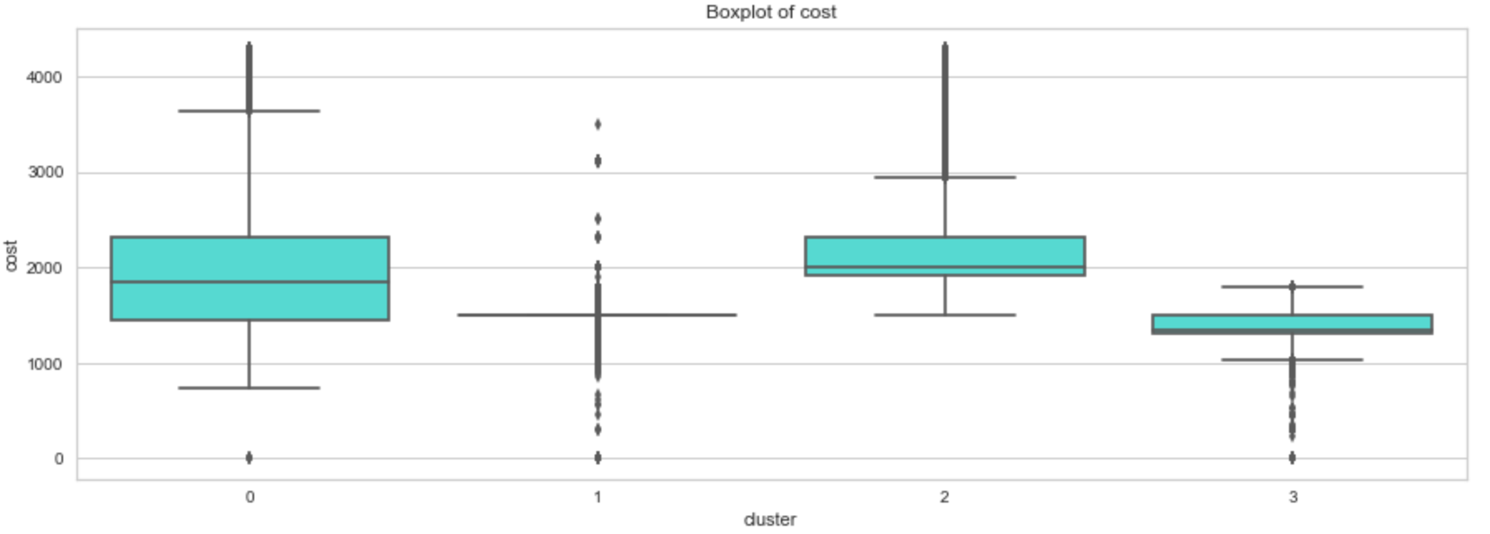
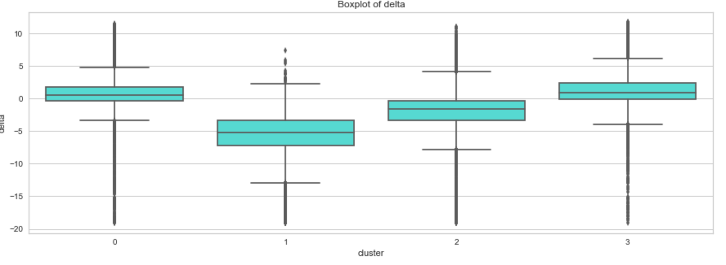
Clustering with standardization

Slide 29
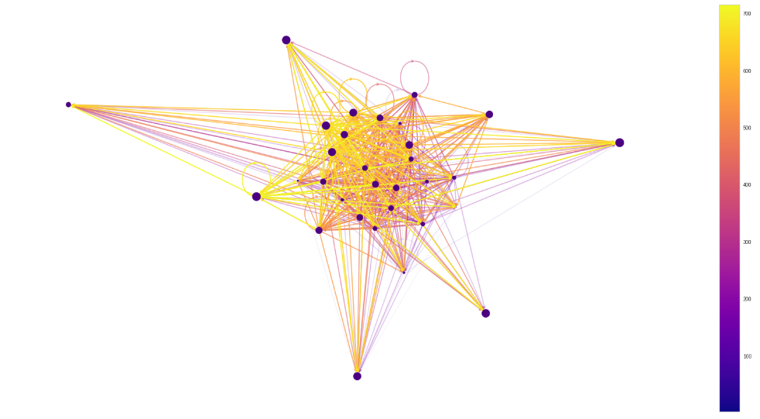
Social network analysis
Does the traffic intensity at the destination point of a delivery influence the delivery time?

Slide 30
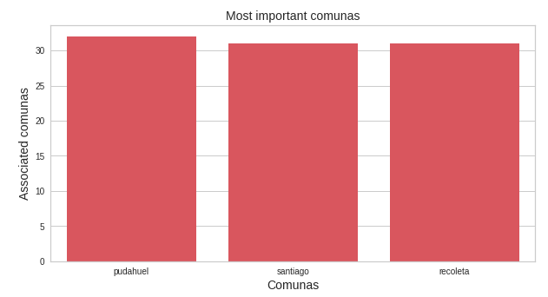
Important comunas: criteria A

Slide 31
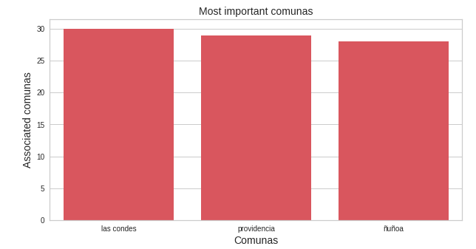
Important comunas: criteria B

